Slide 1

Corporate Presentation

Slide 2

Why First?
Cosmo at its core has always been pioneering revolutionary innovations to create a better life for the people, the planet, and the community we live in; built on trust, empathy, and compassion.
All through our journey, we have prided ourselves in our ability to provide industry-first niche solutions in the areas of packaging, lamination, industrial and labeling applications. We have made inspiring diversifications into speciality chemicals, consumer care, and D2C retail, aiming to be a pioneer in these previously fragmented industries.

Slide 3



What does First Mean?
Positioning Statement
Cosmo First is a four-decade young Indian business conglomerate that thrives on innovation to unlock value in diverse sunrise sectors such as Packaging Films, Technical Films, Speciality Chemicals, Ferrites and D2C Retail (Pet Care).

Slide 4



Vision, Mission and Values
Vision
Mission
We aspire to be recognized amongst the most innovative business conglomerates in India, developing high-growth businesses that are sustainable, scalable and profitable.
To deliver lasting value for all our stakeholders through innovation, excellence, collaboration, integrity & customer-centricity.
Values
Champion innovation to stay a step ahead.
People first, foremost, and above all.
Continue to build customer trust through process & quality excellence.
Thrive together and win as a team.
Act with integrity, no matter what.

Slide 5
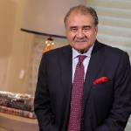
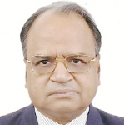
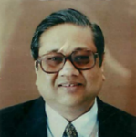
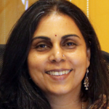
Board of Directors
Mr. Ashok Jaipuria
Chairman & Managing Director
Mr. A K Jain
Director of Corporate Affairs
Mr. H K Agrawal
Independent Director
Mrs. Alpana Parida
Independent Director
Experience- A first generation entrepreneur with over forty years of experience in the corporate world
Education- He holds a degree
in Associate of Arts in Business Administration and diploma
in Marketing Science.
Experience- Over 4 decades
of experience in Finance, Accounts and General Management functions.
Education- He holds a Commerce degree from Meerut University and an AICWA from ICWAI.
Experience- Over 4 decades
of experience in the fields of Strategic Management, Organization Structure, Finance and Training.
Education- He is a Mechanical Engineer from University of Jodhpur and has obtained his MBA from IIM, Ahmedabad.
Experience- More than two decades of experience in
retail and marketing communications in the
US and in India.
Education- She graduated
from IIM-Ahmedabad in and
has a degree in Economics
from St. Stephens, Delhi University.

Slide 6
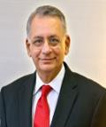
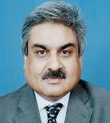
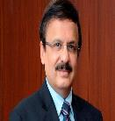
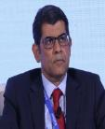
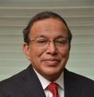
Board of Directors
Mr. Pratip Chaudhuri
Non-Executive & Non Independent Director
Mr. H N Sinor
Independent Director
Mr. Anil Wadhwa
Independent Director
Mr. Rakesh Nangia
Independent Director
Mr. Arjun Singh
Independent Director
Experience - Ex- Member of
the IFS, he has served as Indian Ambassador to Several country
Education - He holds a
Master’s Degree in History
with specialization in Chinese History and Medieval Indian History and Architecture.
Experience - 4 decades of experience in advising Fortune 500 multinationals and Indian Business houses on a wide range of matters.
Background - He is a council member of PHD chambers, member of CII's national committee on Taxation and member of FICCI's Council for Taxation.
Experience – 25 years of experience in running and growing businesses.
Background - Currently the Managing Director for Asia and the head of Envestnet | Yodlee's growing operations in India, he has held senior roles at Aon Hewitt in Asia, WNS, ABN AMRO Bank in Amsterdam, and more.
Experience - Extensive experience in the fields of Corporate Finance, Treasury, Asset Management and International Banking.
Education - He holds a BSc. (Hons) Degree from St. Stephen's College DU.
He is also an MBA from
UBS, Chandigarh.
Experience - over 4 of Experience decades in public as well as private sector banks like UBI, Central Bank of India and ICICI Bank.
Background - He is also associated with various charitable and other trusts engaged in social activities.

Slide 7
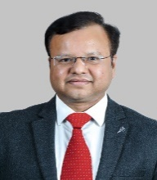
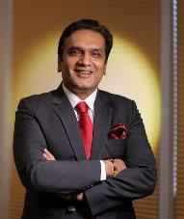
Leadership Team
Mr. Pankaj Poddar
Group Chief Executive Officer
Mr. Neeraj Jain
Group Chief Financial Officer
Experience - Over 24 years of experience in finance, advisory and various leadership roles.
Education - Bachelor of Commerce (Honors) from SRCC, qualified Chartered Accountant and diploma in management.
Experience - Over 17 year
of experience in working
With large manufacturing
and service industries.
Education - Bachelor of Commerce from DU and
a qualified Chartered Accountant.

Slide 8
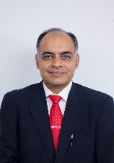
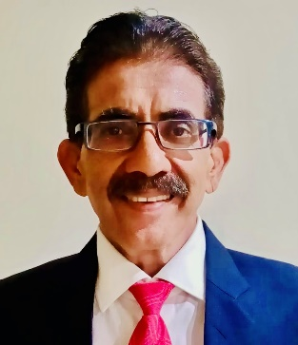
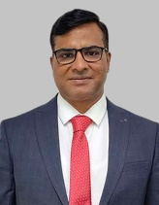
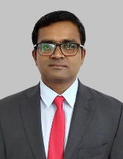
Leadership Team- Business Heads
Mr. Kulbhushan Malik
Business Head- Cosmo Films
Mr. Sanjay Chincholikar
Business Head- Technical Films & Rigid Packaging
Mr. Ambarish Sikarwar
Business Head- Cosmo Films B2C
Pets Business
Dr. Anil Vilas Gaikwad
Business Head- Cosmo Speciality Chemicals
Experience - Over 38 years of experience in the fields of manufacturing, engineering, projects, R&D, Technical services, quality control & sales.
Education - Mechanical Engineer and B.Comm and post graduate in Sales and Marketing.
Experience - Over 20 years of experience in the areas of Business & Strategy Management, Sales and
Financial management.
Education - B.Com (H) from SRCC, a qualified Chartered Accountant and holds a diploma in management.
Experience - 19 years of experience in consumer categories.
Education - Graduation in Science from Dr. Babasaheb Ambedkar University, Agra and MBA in Finance & Marketing from IIT, Dhanbad.
Experience - 14 years of experience in wide range of polymer synthesis techniques, inorganic and high temperature ceramic coatings.
Education - Doctorate degree in Chemistry (Nanotechnology)

Slide 9
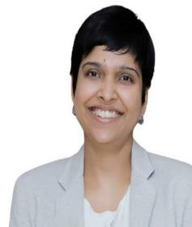
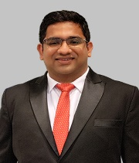
Leadership Team- HR & IT
Ms. Ashima Roona
Head- Human Resources
Mr. Sriram Arthanari
General Manager- IT
Experience – 10+ years of experience as Program & Project Management, Tech implementations for SAP, Sales & Distribution Modules, Data Governance among others.
Education - B.E. from College of Engineering, Guindy and MBA from IIT – Bombay.
Experience - Over 16 years
of experience in different Human Resource Verticals.
Education - MBA (PGDPM) from XISS, Ranchi and graduate from Jesus and Mary College, DU.

Slide 10


Slide 11

Our Brands
Zigly is an omni channel platform, and its tagline- For Happy Pets, signifies how the brand is creating a change in the pet care industry and helping pets and their parents provide everything under one roof to make them happy.
The Tagline- Engineered to Enhance comes from the fact that the company engineers products that enhance shelf life, quality and printability of the final end product
The tagline- We Value Bonding signifies our expertise in Chemistry and how our created products are top notch. It also has a dual understanding which relates to the quality of the adhesives we make.

Slide 12
ESG- Environment, Social and Corporate Governance

Slide 13
Cosmo Foundation- An Overview
Basic Computer Literacy & Digital
Skill Building
Basic English
Literacy & Fluency Development
Cosmo Gyan Vihar Kendra - Native Language, Maths,
Life Skills & Values
Educational Counselling & Career Guidance
Cosmo Digi Pathshaala - Online Learning Platform for rural students
Cosmo Udayan
Shalini Fellowship - 30 Girls sponsored
Education
Cosmo Computer Award &
Children’s Fair
Exposure &
Trainings of Youth
and Teachers
Celebrations of National Days & Festivals
Computer & English courses in Summer break
Parents Engagement
Health & Sanitation
Toilets in Rural Schools No: 100
Sanitary Pad
Bank for Girls in
Rural Schools
Oral Hygiene awareness & Dental Check-ups
Nutrition & Reproductive
Health awareness
Behavioural Change
Tree Plantation
With Farmers and Rural Schools
No: 6000+
Garden Development at Aurangabad Airport & Karjan Flyover
Waste Bins Installations in Rural Schools
No: 400+
Water Tanks in
Rural Schools
No: 6
Environment
Beneficiaries since
Inceptions
40000
Students
1 Lakh Community
Members
42 Govt.
Schools
112 Extended
Villages

Slide 14
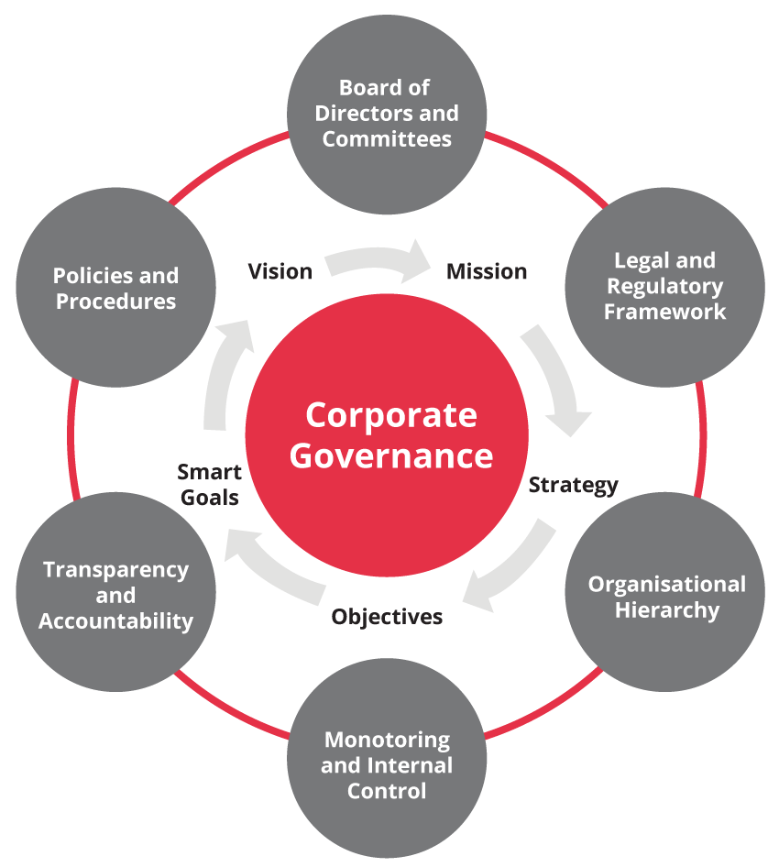
Corporate Governance
Well established practices in place
Well qualified Board of Directors from diversified fields
with majority of directors being independent.
Independent Audit Committee with Board of Directors.
Established risk management practices.
Experienced and independent internal audit function.
Active Whistle Blower Policy.

Slide 15




Sustainable Manufacturing Practices
Recycling of manufacturing
waste for further film
production as well
as packing materials such
as cores, hollow sheets etc.
Constant monitoring of parameters like noise, illumination, ventilation,
air quality etc.
All plants use some
amount of solar power
as a source of energy.
Continuous efforts to
reduce water usage,
waste generation and
GHG emissions.
Rain water harvesting
and reuse of effluent
treated water.

Slide 16
Sustainable Product Practices
Offer mono-material poly-olefin films for ease of recycling.
UV stabilized Synthetic Paper can be used to replace PVC in outdoor promotional applications for shorter duration requirements up to one year.
1
8
Designed heat resistant BOPP films replacing BOPET; mostly used in print layer, giving last push to creation of mono-material structures.
2
7
Use of Water Based Coatings.
Company has been partnering with some of the best global brands to offer structure rationalization.
3
6
Offer Oxo-Biodegradable Films.
Both BOPP and CPP films offer better yield, hence enabling reduced consumption of plastics.
4
5
Offer a suitable substitute for aluminum foil in form of its Ultra-High Barrier Films.

Slide 17
Cosmo Films

Slide 18
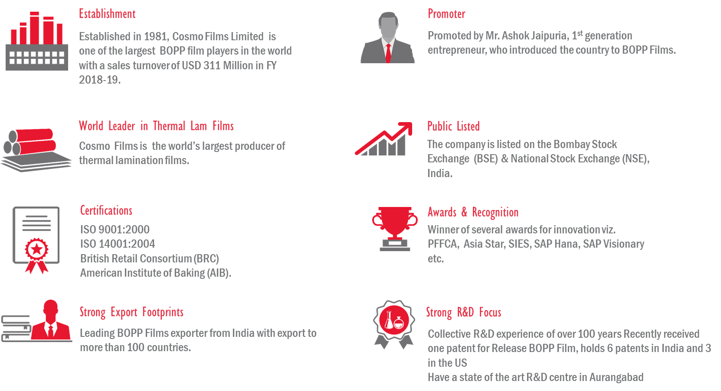
Cosmo Films- Why Us?

Slide 19
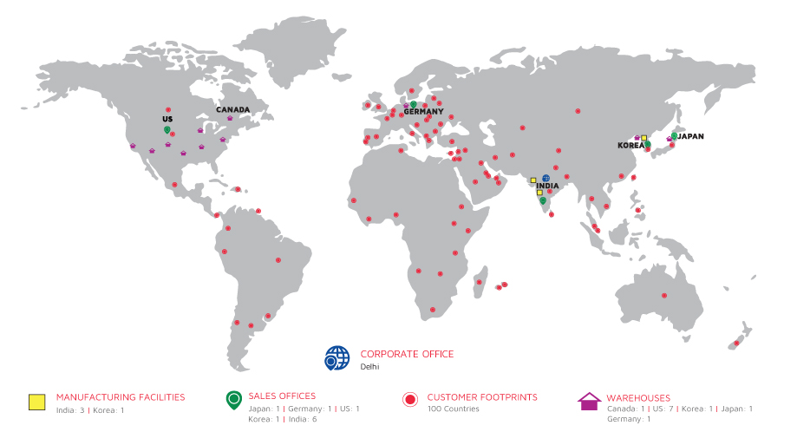
Global Footprint

Slide 20
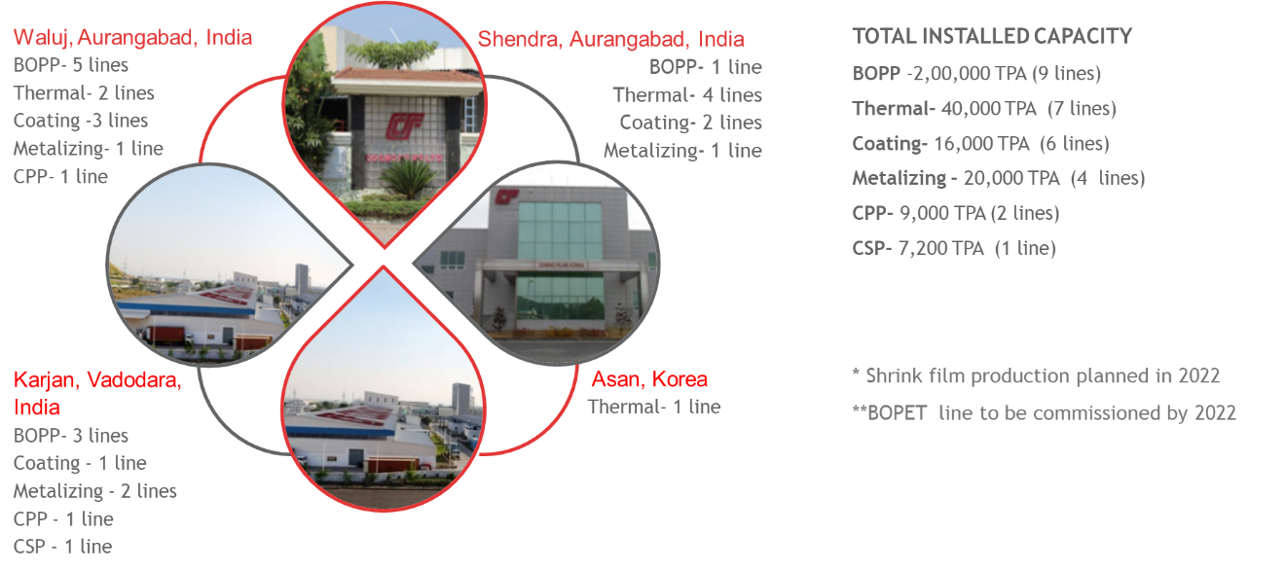
Manufacturing Footprint

Slide 21








Product Portfolio
PACKAGING FILMS
LAMINATION FILMS
LABEL FILMS
INDUSTRIAL FILMS
Print & Pouching Films
Transparent Barrier Films
Metalized Barrier Films
Overwrap Films
Standard Range
Special Application Lamination Films
Premium Lamination Films
PS Label stock Films
In-Mould Films
Wrap Around Label Films
Synthetic Paper
Tape & Textile Films

Slide 22
Cosmo Speciality Chemicals

Slide 23
Cosmo Speciality Chemicals
Cosmo Specialty Chemicals
Textile Additives
& Chemicals
Master batch
Adhesives
Textile additives
Polymer resin
Fillers
Compounding
Adhesives for B2C
Packaging
adhesives

Slide 24
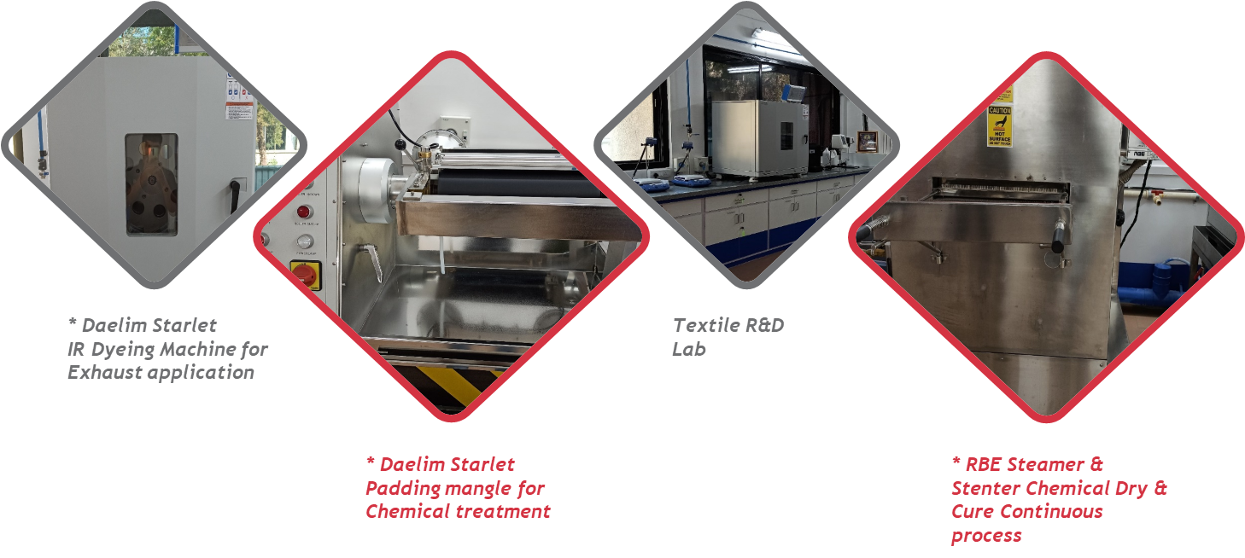
R&D Infrastructure

Slide 25
Zigly

Slide 26
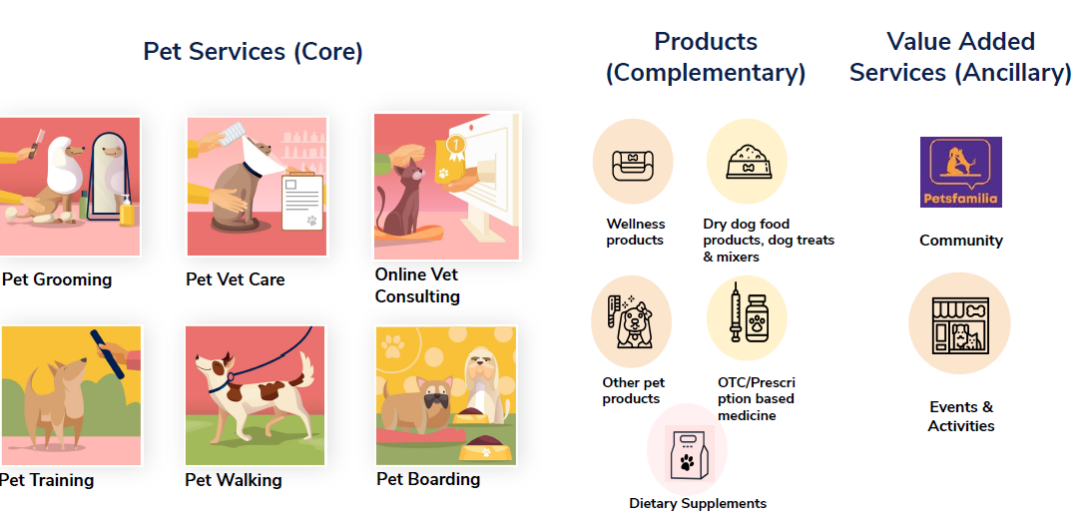
Portfolio- Zigly

Slide 27
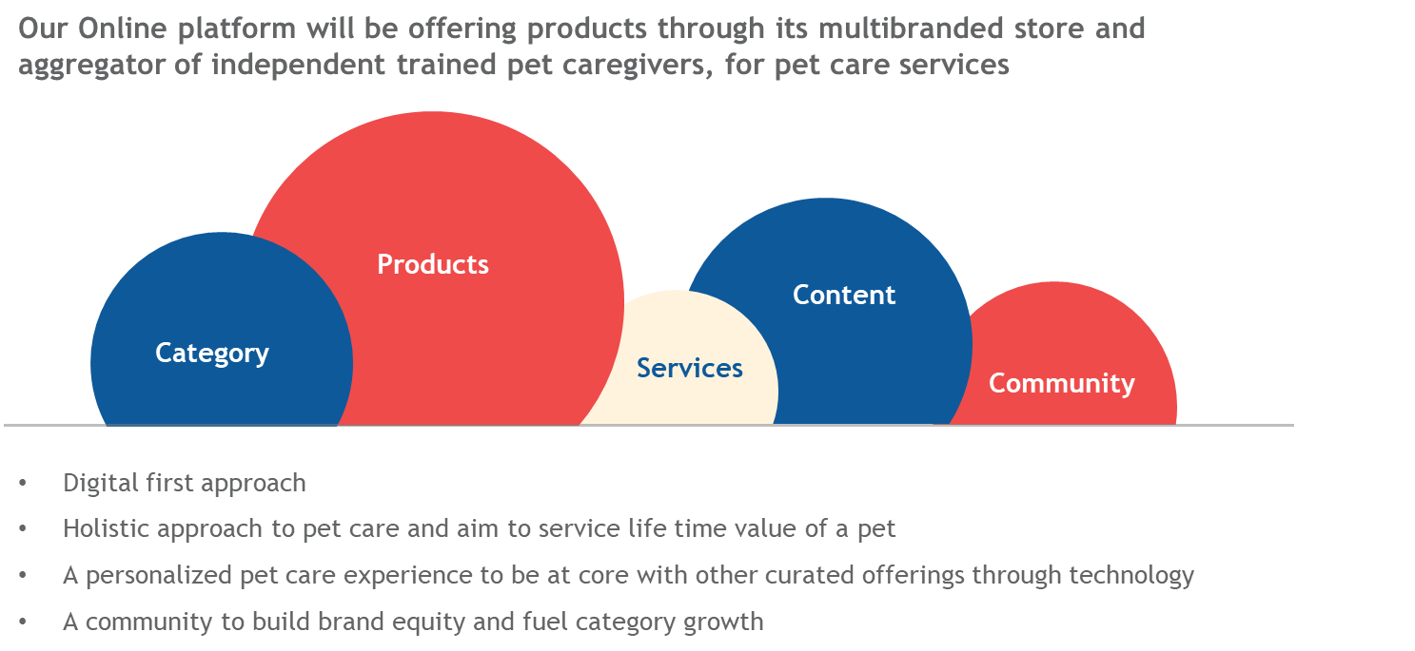
Digital Overview

Slide 28
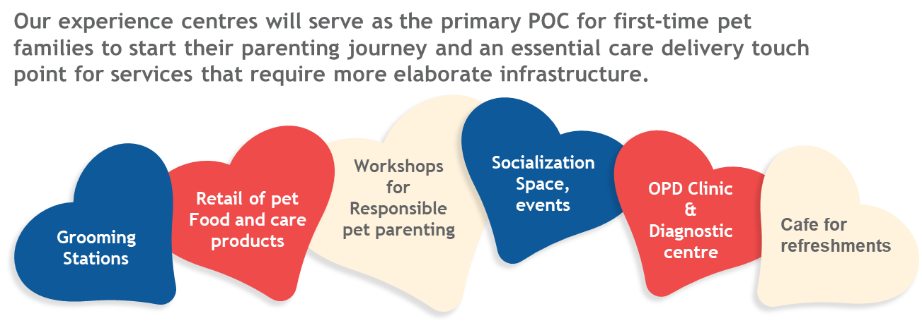
Offline Overview
The Experience Centre will act as an important hub and integrating point for a unified pet care experience for pet families.
The aim is to create a centre that becomes an important occasional fixture for pet care services which cannot be delivered at home with ease.
The first centre will be launched in Delhi NCR and will be operational in Phase 1 of MVP.

Slide 29


